Slide 2
Reference link
https://www.dj4e.com/assn/dj4e_autos.md?PHPSESSID=6bce21472e68ed7987b4a25ef7d1f0e4

Slide 3

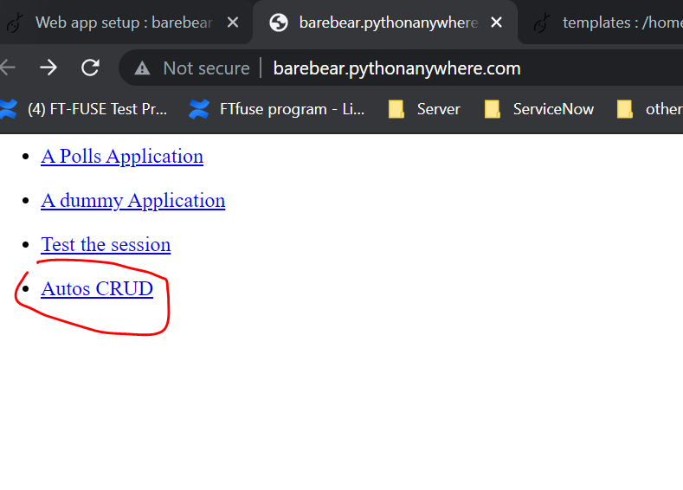
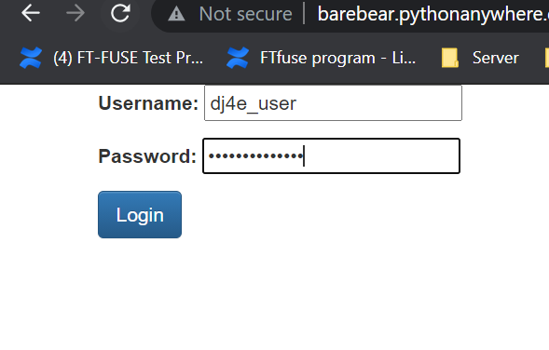
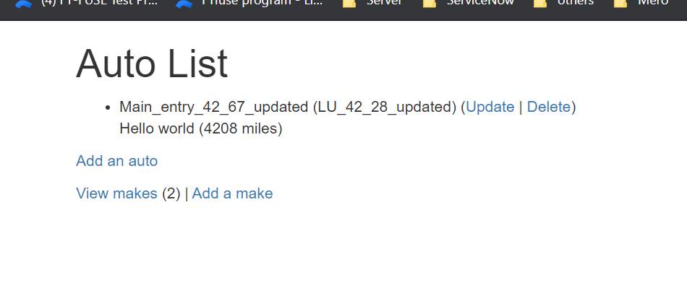
Final results

